Slide 1

Integration Test Plan Doc.
Marinelli Matteo
Raspa Niccolò

Slide 2
Entry Criteria
Stakeholder Approval
Website and Mobile App: communication
Coding and Testing Application Layer
Single component test before integration test
Code Inspection
Documentation (classes and functions in JavaDoc)
Object relational mapping (microservice with respective database)

Slide 3
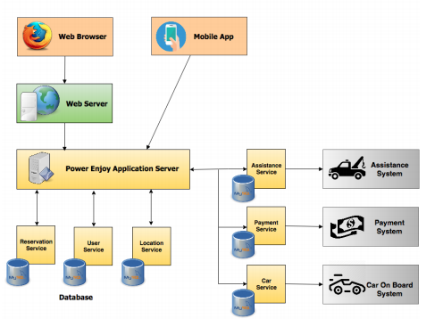
Elements to be Integrated

Slide 4
Integration Testing Strategy
Assure that services in relations with external systems works as expected
Assure that we have control over the Car
Integration of Services
Integration with top layers
Alpha Test

Slide 5
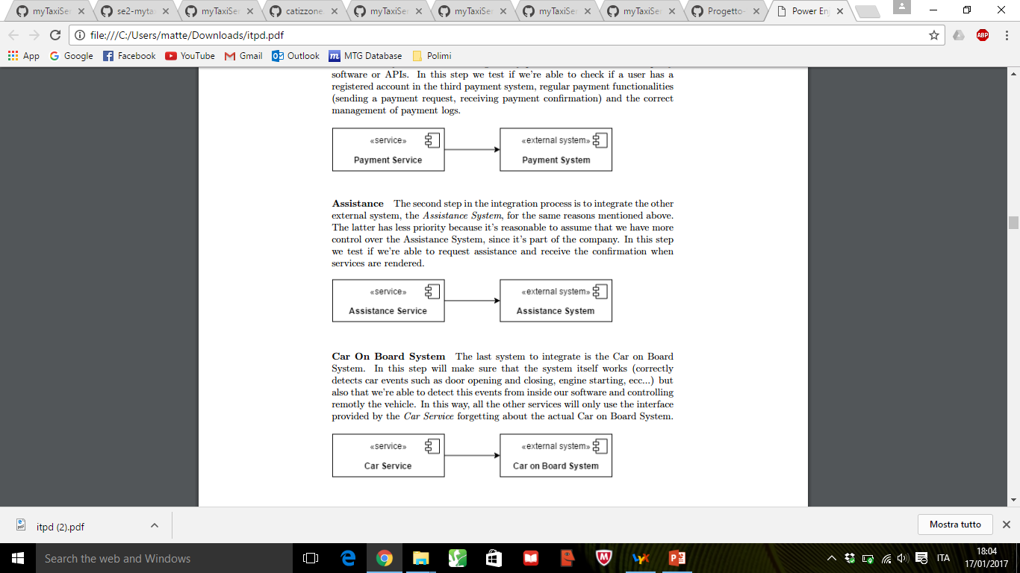
External Systems

Slide 6
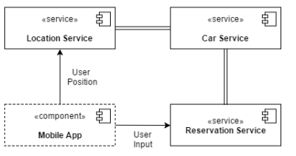
Reservation

Slide 7
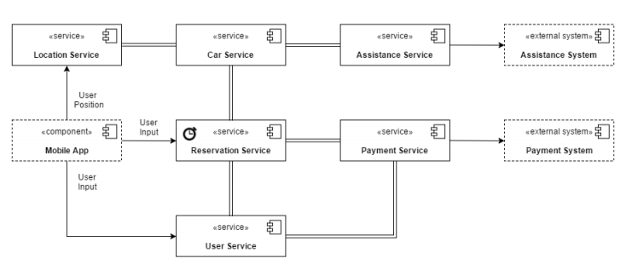
Other Functionalities

Slide 8
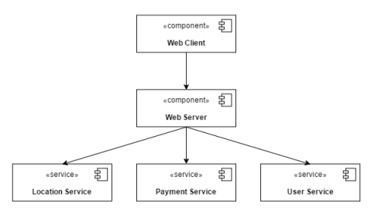
Web Subsystem

Slide 9
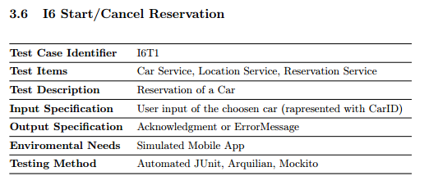
Individual Steps and Test Description: Example

Slide 10
Individual Steps and Test Description
Payment: check account, payment request, payment confirmation, insert/update payment logs
Assistance: assistance request, assistance confirmation
Car On Board System: functionality test, lock/unlock, information stream
Location of Cars: monitoring, safe/unsafe park detection
Car Selection
Start/Cancel Reservation: reservation, cancel, unlock
Driving/End Reservation
Timing
Payment of Reservation
User & Profile Management
Assistance (if a car become malfunctioning request assistance)

Slide 11
Tools and Test Equipment Required
Manual Testig
JUnit
Mockito
Arquillian
Devices
Power Enjoy Cars
Drivers and Stubs

